Slide 1
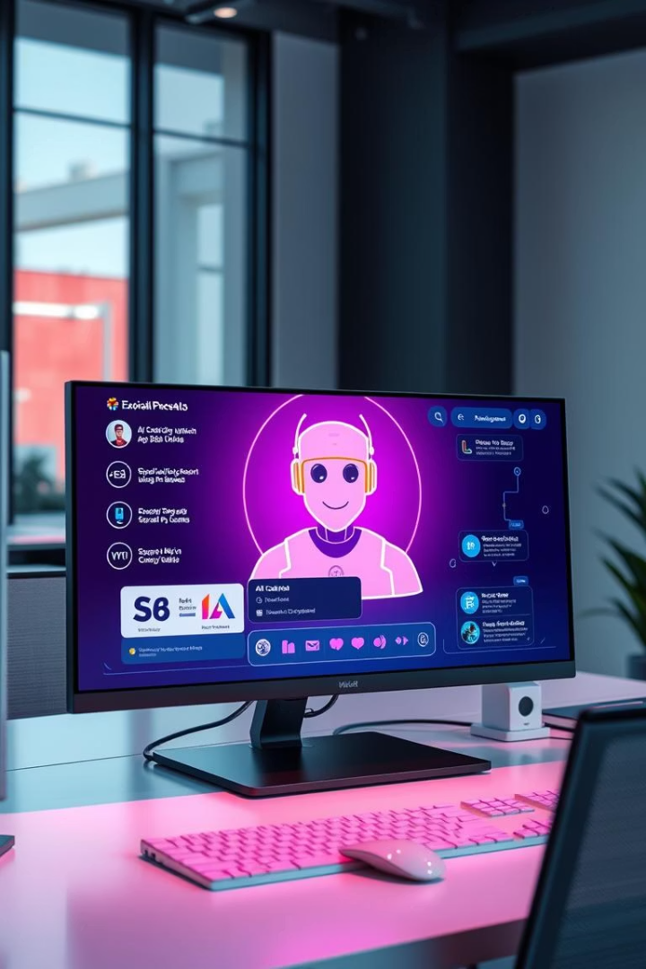
PDF-based AI Chatbot
Chat with your documents using Hugging Face + Streamlit
By: Ananya Singh & Vidhi Mitra.

Slide 2
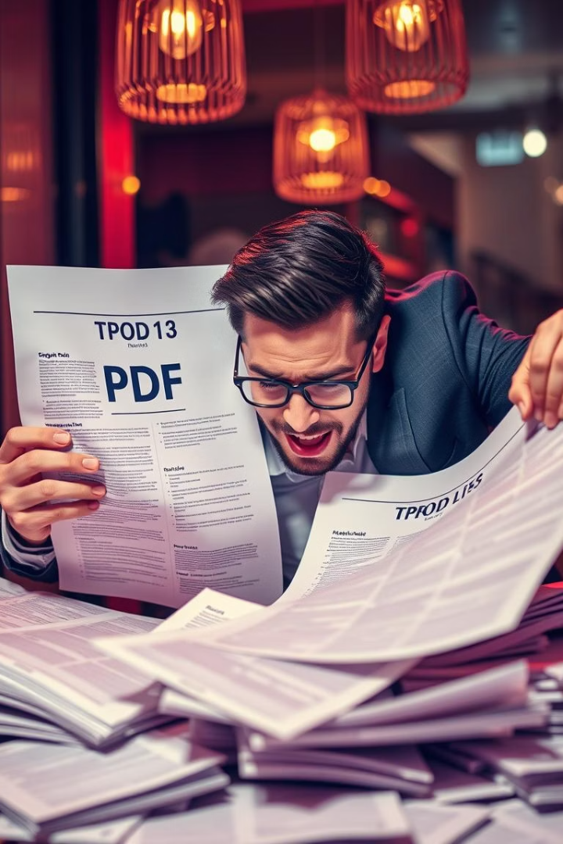
Problem Statement
Reading large PDFs is time-consuming
No easy chatbot interaction for documents
Need fast, intelligent PDF question answering

Slide 3

Objectives
Understand PDF content
Answer user questions
Process and analyze uploaded PDFs
Receive direct answers from documents
Deploy with web UI
Easy access via Streamlit app

Slide 4
Models and Libraries
Hugging Face Transformers
PyMuPDF (fitz)
Streamlit
Pyngrok (optional)
Extracts text from PDF files
Builds the web interface
Exposes app for external access
QA model like 'deepset/roberta-base-squad2'

Slide 5






Workflow / How It Works
Upload PDF
User provides document
Extract text
PyMuPDF pulls textual content
Ask question
User inputs query in chat
Query model
Hugging Face model processes input
Get answer
Model returns relevant response
Display reply
Streamlit shows answer to user

Slide 6



Conclusion & Future Scope
User-friendly UI
2
Streamlit interface for ease of use
Efficient Answers
1
Fast extraction and response from PDFs
Future Enhancements
3
Multiple PDFs, memory, citations

